Slide 1
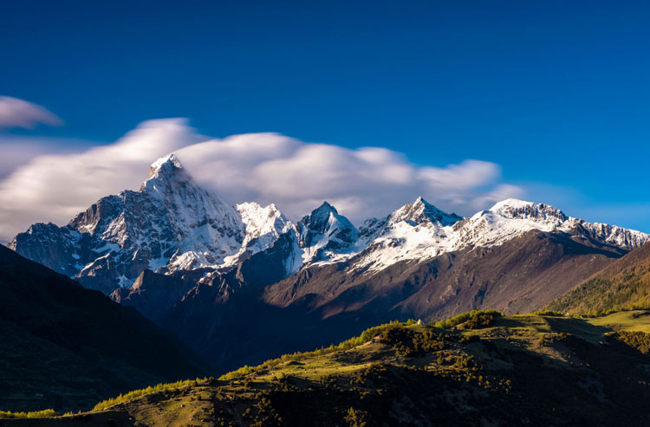
China – A Brief Introduction to Tourism
Profiling Swot Analysis and Covid Impact Submitted for International Tourism Management Course To: Dr Vanessa (Gaitree) GB GOWREESUNKAR By- Ankit Singhal (MBATHM02003)

Slide 2
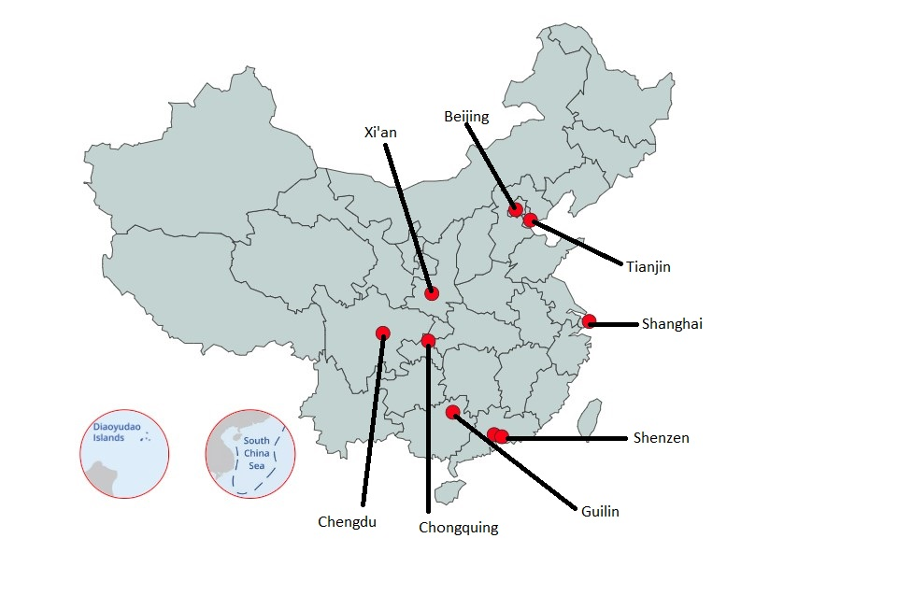
China – A brief Introduction
China is a populous nation in East Asia whose vast landscape encompasses grassland, desert, mountains, lakes, rivers and more than 14,000km of coastline. Capital Beijing mixes modern architecture with historic sites such as the Forbidden City palace complex and Tiananmen Square. Shanghai is a skyscraper-studded global financial center. The iconic Great Wall of China runs east-west across the country's north.

Slide 3
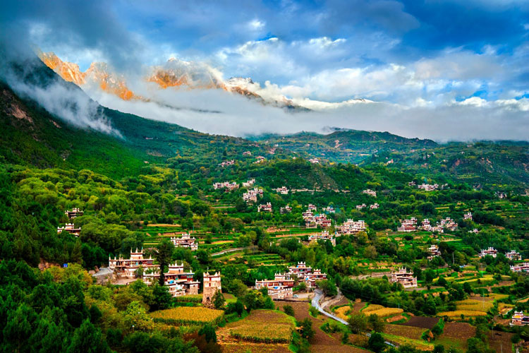
Sichuan Province
Sichuan, “Chuan” for short , is the largest province in western China. Due to its abundance of natural resources, it is renowned as the “Land of Heaven.” It is the hometown of Giant Pandas
The climate is greatly different in eastern and western Sichuan. Sichuan Basin enjoys a subtropical climate, which is humid and cold in winter and extremely hot and stuffy in summer, and very humid. Western Sichuan has a plateau mountain climate with less rainfall and colder winters.

Slide 4
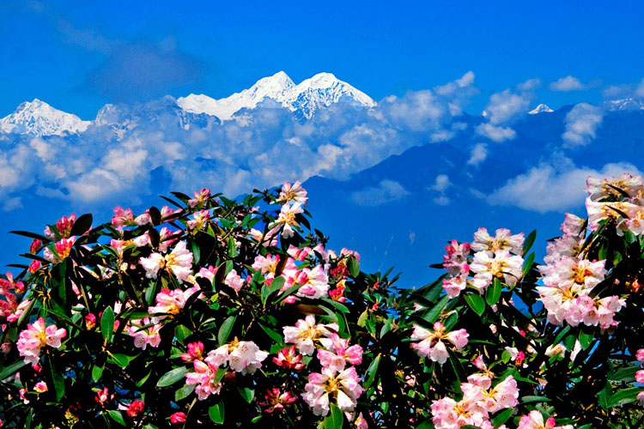
A beautiful landscape view of Sichuan

Slide 5
Chengdu
Chengdu is in southwest China with a long history and abundant cultural resources. It is one of China’s top national historical and cultural cities. It has been hailed as the “Land of Heaven” since ancient times.
Mount Siguniang
Mount Siguniang is famous for its grandness and straightness. The steep mountain points highly toward the blue sky just like the beautiful scenery of southern Europe, and is known as the “Oriental Alps.” It is a famous holy mountaineering place.

Slide 6
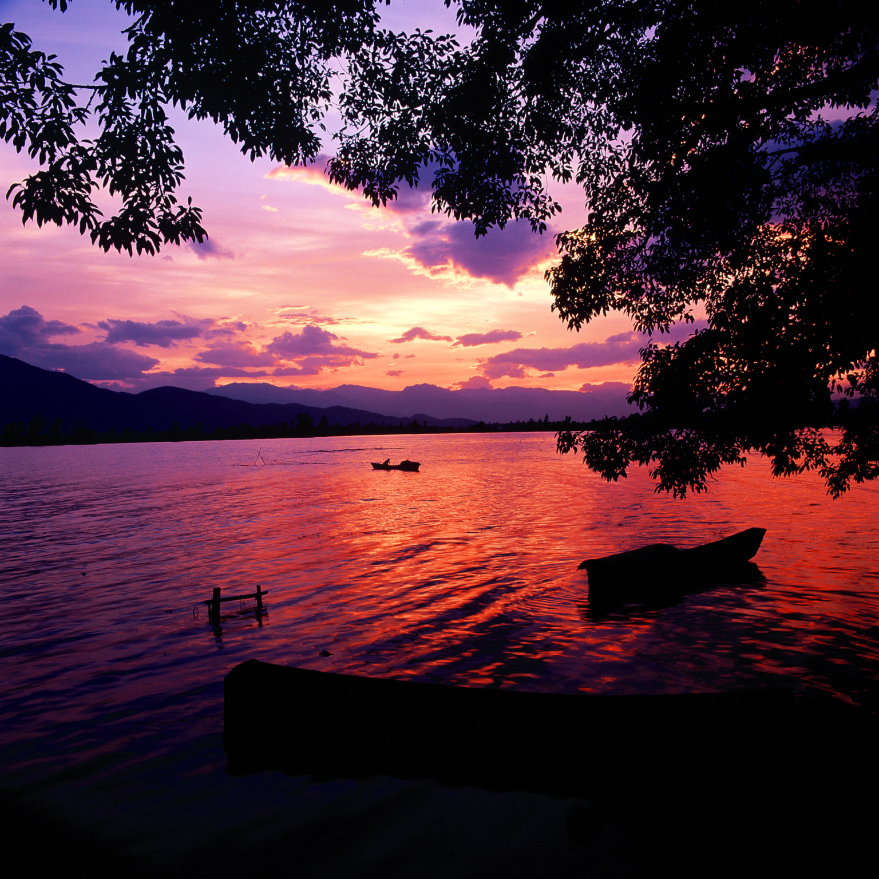
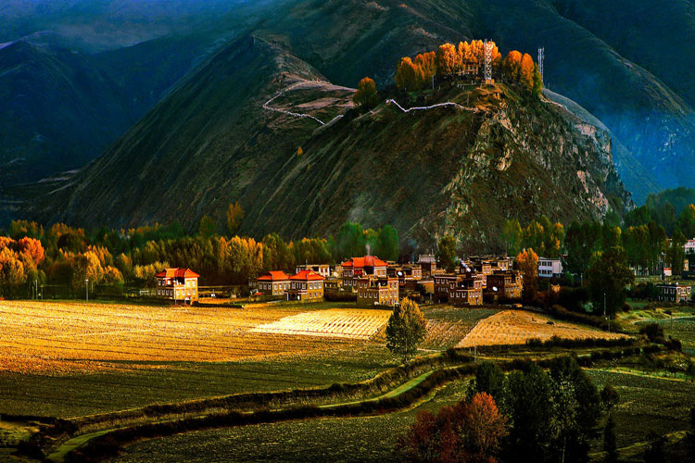
Xichang - Qionghai Lake
Qionghai Lake is known for its quietness and lucidity. The four seasons bring different scenery to the lake. Qionghai not only has beautiful scenery but also many wonderful folk legends which add to its mystery and beauty.
Danba - Jiuju Tibetan Village
Jiaju Tibetan Village rises layer by layer from the Dajin River Valley and extends to the foot of the Kapama Peaks. Seen from afar, the Kapama Peaks are like a mother opening her arms to hold the mountain villages safely.

Slide 7
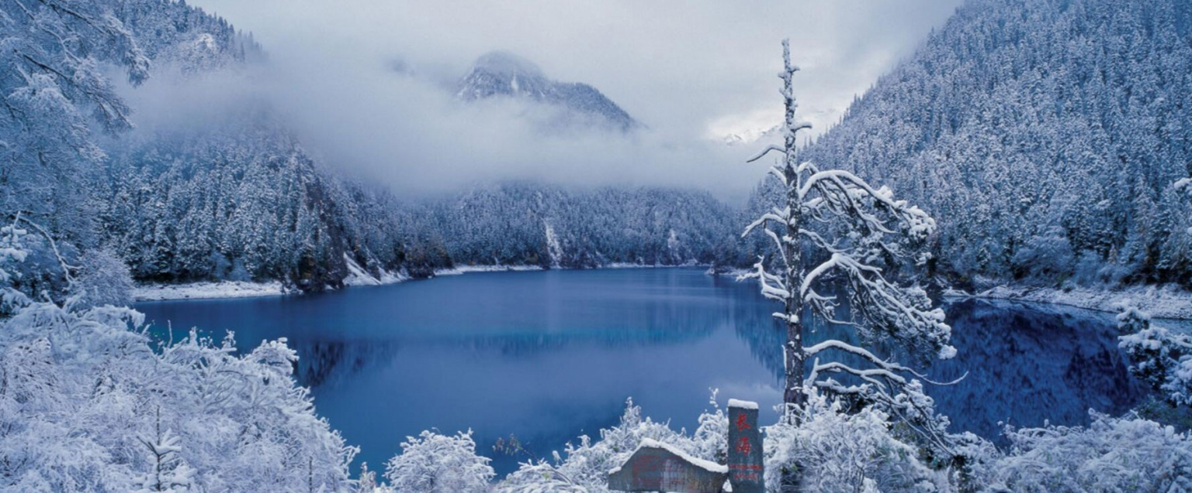
Jiuzhaigou Valley
Jiuzhaigou Valley got its name because there are nine Tibetan villages in the valley. At an average altitude of 2,000 to 3,000 meters, the scenic area is renowned at home and abroad for its “five wonders”: Green Lake, Overlapping Lake, colorful forests, snow­-capped mountains, and Tibetan customs. \

Slide 8
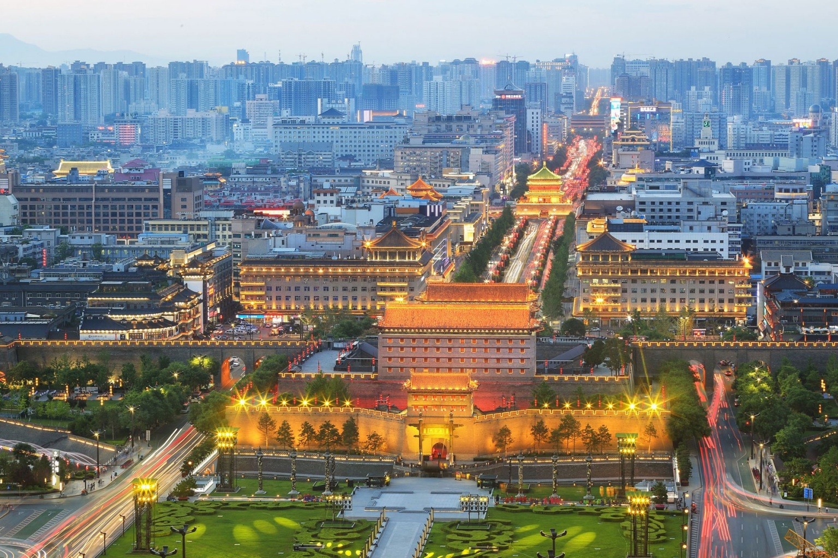
Part 2: Sino-Indian Cultural Differences and Their Impact on Tourism - (Xiang Baoyun)
Xi’an, known as Chang’an in ancient times, was historically the capital of 13 dynasties. It is the capital with the longest history and the greatest influence over the most dynasties, ranking first among ancient capitals in China, hailed as “the natural history museum”

Slide 9
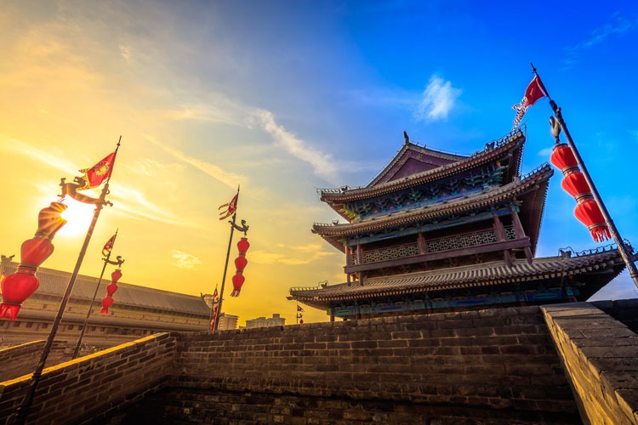
Sino-Indian Cultural Differences and Their Impact on Tourism
Both Chinese and Indian cultures belong to the oriental culture. During the long history both the countries have influenced and learnt from each other (Guo Hongji, 2011). However, there are great differences in terms of cultural types and cultural differences. It is possible to analyse their differences from three different perspectives:- 1. Ethical Culture Vs Religious Culture
2. Unitary Culture Vs Multi Culture
3. Culture of Optimism Vs Culture influenced by spirituality and myths about afterlife.
Xi'an Ancient City Wall
Xi’an Ancient City Wall is China’s best preserved ”defense” strategy, and includes moat, drawbridge, gate building, watchtower and other tightly organized military facilities.

Slide 10
1. Ethical Culture Vs Religious Culture
It is often argued that Chinese culture is ethical centering on Confucianism and Mencius (a system of philosophical and ethical teachings founded by Confucius and developed by Mencius), whereas Indian Culture is religious centering on Hinduism. The major components of Chinese culture include: benevolence, righteousness, sense, wisdom, belief, the Doctrine of the Mean, human orientation and atheism combined with the deep rooted ideology of “the big unification”. However the major components of Indian Culture includes: Doctrine of tolerance, asceticism (self discipline), worship of spirits, retribution(punishment) and samsara, racial system, and bodhidharma. Its outstanding characterstics are that all its religious doctrines and concepts lie in the human hearts and behaviors. Followers of this religion look for soul purification, maintenance of the racial system, promotion of non-violence, and believe in cause and re-incarnation.

Slide 11
2. Unitary Culture Vs Multi Culture
Chinese culture is co-created by United Chinese Nation, which is a blend of multiple ethnics living in the Huanghe River Basin and Yangtze River basin. Chinese culture is quite unaffected by foreign cultures in history and for thousands of years, the culture has been passed down from one generation to another without any interruption. It is a typical example of Unitary culture. On the other hand, historically, India is closely linked with various countries, nations, and religions, making its culture like that of a colour palette. Since the 15th Century BC, people such as Australian aborigines, the Mediterranean ethnics, Armenians, Dravidians, Aryans, and Mongolians came to live in India one after the other. They co-existed with Indian aborigines (Negley people) co-created the Indian culture system. The Indian culture has been continuously invaded by foreign civilisations, such as Aryan culture, the Islam, and the British culture, forcing it to absorb different foreign elements to enrich its own culture. It is a typical example of multi-culture.

Slide 12
3. Culture of Optimism Vs Culture influenced by spirituality and myths about afterlife
The Chinese culture pays great attention to worldly happiness. Since, ancient times, from the elites to common people, from daily necessities to topics of sex, health, longevity, and entertainment, they all demonstrate the belief in being content with the status quo, of doing what one enjoys and avoiding what one worries about (Chen Youyi, 2003). They also believe in the ideology of "after the rain comes the sunshine", and "every cloud has a silver lining". Though people understand that after death there is no spirit, and that life is too short and filled with uncertainty, they still show great hopes for the future, believing that as long as they keep on going and practicing, they will embrace their good luck one day. Therefore, they pursue happiness in celebrating births, being alive and their daily life. In short, Chinese culture is a typical culture of optimism. Hindusim believes that the more one suffers, the more his soul will be superior and he will be closer to God and happier in the afterlife. So, it is no wonder that in history, prince Sakyamuni gave up the crown to become a beggar for years before he ascended to the stage of Buddha. Mahivira, the founder of Jainism, abandoned his prince title to become a sadhu, being less aware of the ants creeping on his body. Today, there are still a lot of people who choose to adopt vegetarianism and are ready to become a sadhu. It is fair to conclude that, Indian culture is a typical example of a culture influenced strongly by spiritualism along with myths about the afterlife.

Slide 13
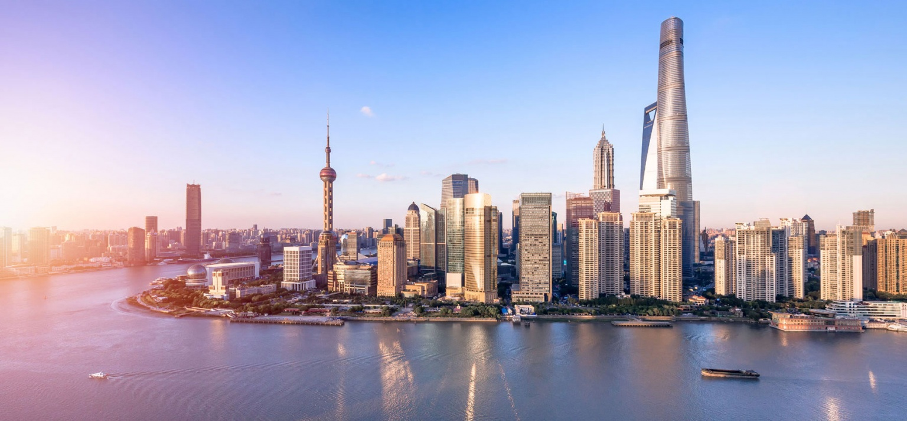
Part 3: Popular Attractions in China Source: China’s National Tourist Office (CNTO), secondary research Travel China- China.org.cn Visit China (www.gov.cn)

Slide 14
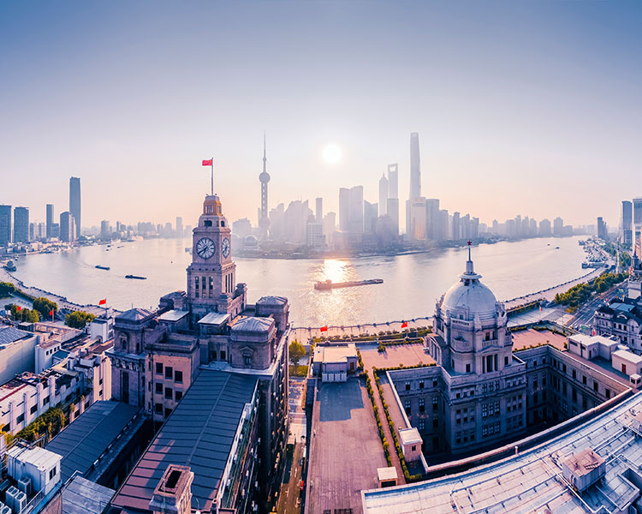
1. The Bund
Shanghai’s iconic stretch of waterfront, The Bund, is pure glamour. Skirting the winding Huangpu River, The Bund has an old-world European vibe rooted in its past as a booming financial hub during the early 20th century.

Slide 15
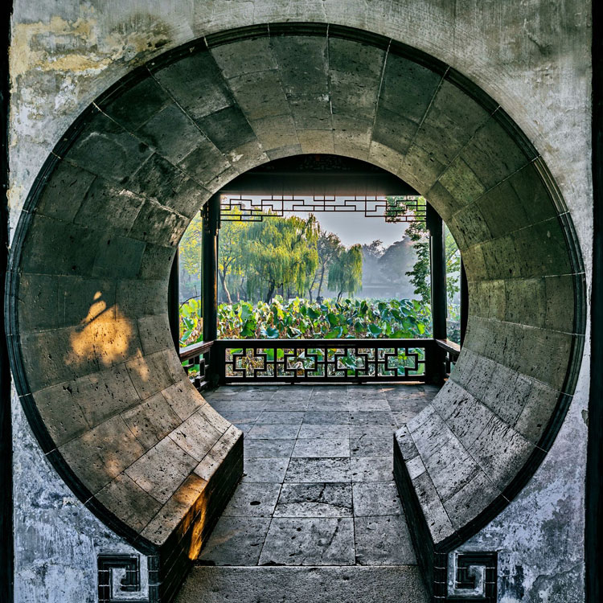
2. Zhuozhengyuan
Located in northeastern urban district, Zhuozhengyuan is the largest private garden in Suzhou and an important cultural unit under state protection. It has been included on the World Cultural Heritage List. Water and rockeries are arranged to represent a pond and three isles, and featuring a simple and natural touch, they well preserve a style of the Ming Dynasty.

Slide 16
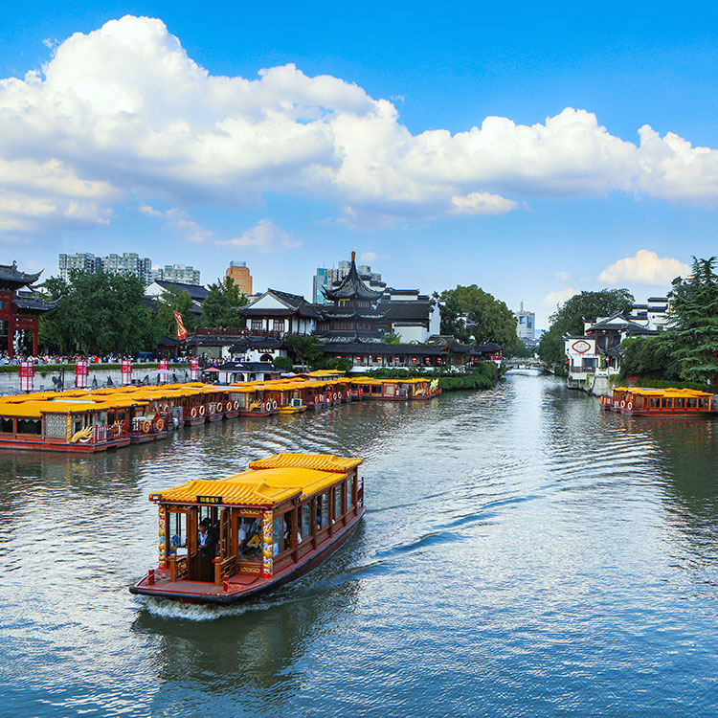
3. Confucius Temple
Confucius Temple is a holy shrine of Confucius, a great thinker and educator of ancient China. Here, all the gates and halls are named “Dacheng (Great Accomplishments),,, implying the great accomplishments achieved by Confucius.

Slide 17
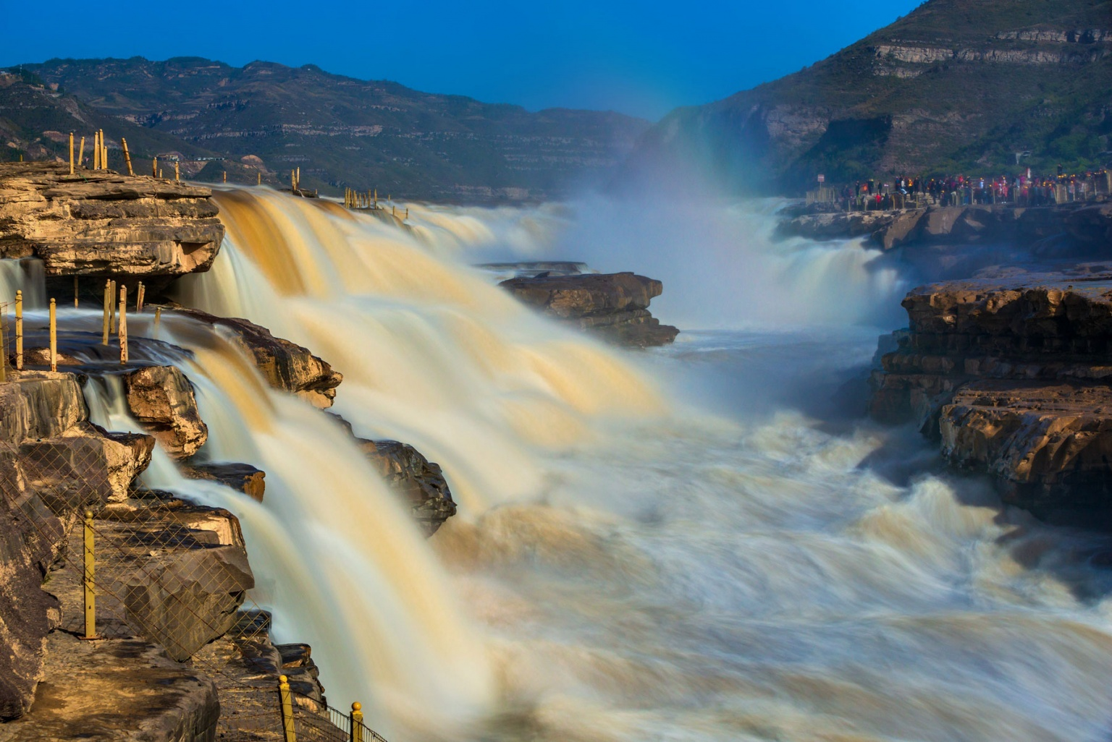
4. Hukou Waterfall
The Hukou Waterfall is the largest waterfall on the Yellow River, the second largest waterfall in China (after the Huangguoshu Waterfall in Guizhou), and the world’s largest yellow waterfall.

Slide 18
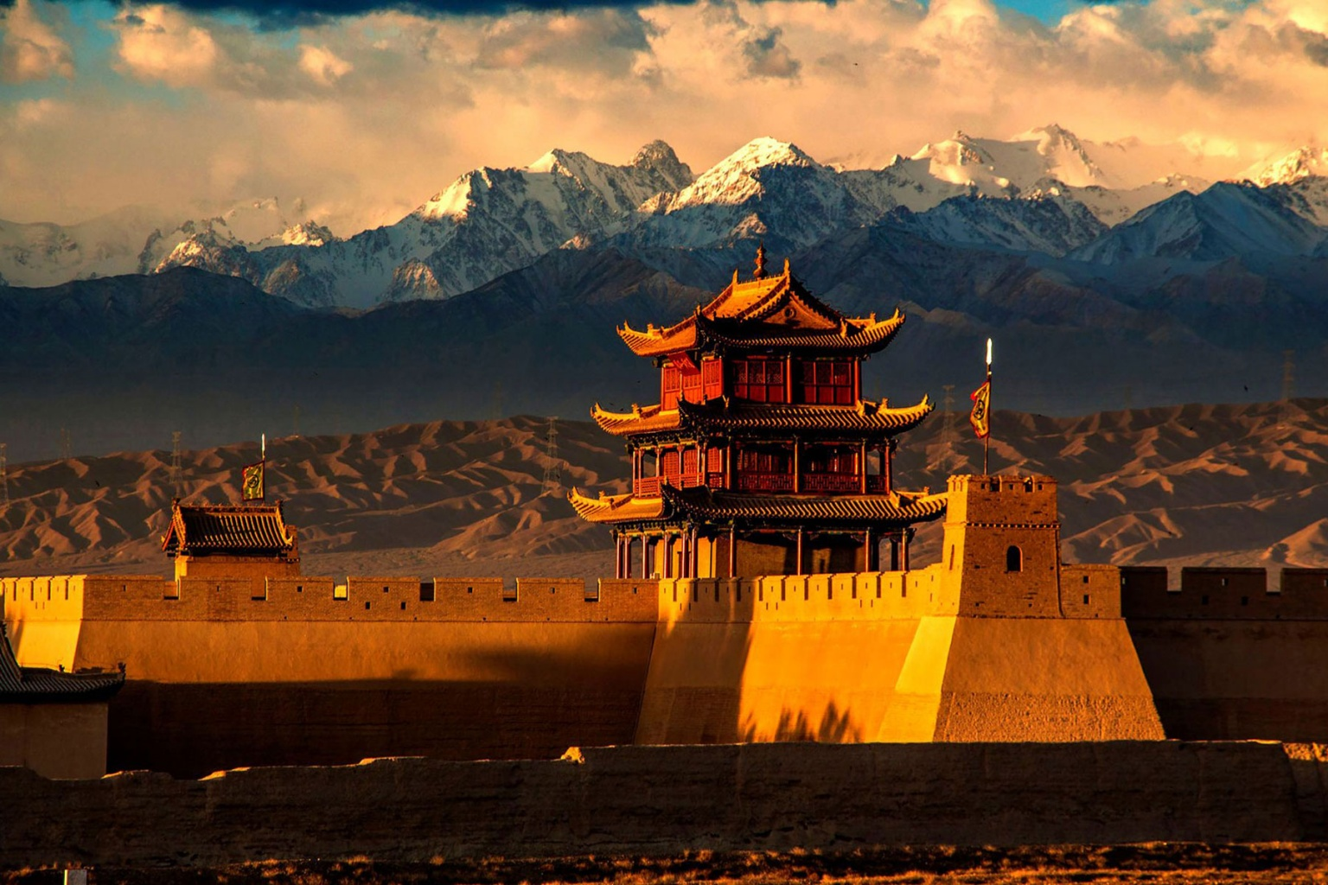
5. Jiayuguan the pass in the desert
Jiayuguan Great Wall was built with rammed earth, making yellow its dominant hue and helping the pass blend harmoniously with the surrounding desert. The city where the pass is located is named after the pass, also called Jiayuguan, sitting in China’s northwest Gansu Province.

Slide 19
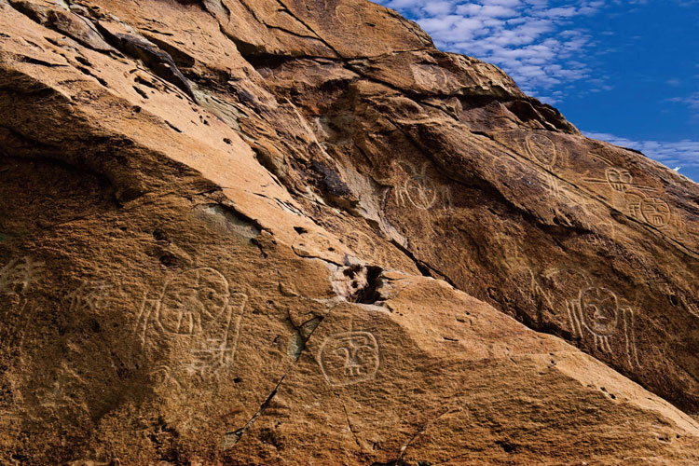
6. Cliff paintings on the Helan Mountains
At the mountain foot of Helan some 50 kilometers from Yinchuan, there are tens of thousands of paintings carved by ancient nomadic tribes on cliffs and rocks, dating to 6,000 years ago. The paintings are mostly devoted to human faces, handprints, and hunting and sacrificing images, as well as various animals.

Slide 20
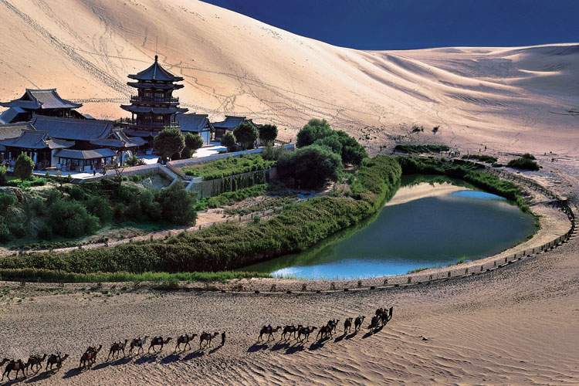
7. Mingsha Hill and Crescent-Moon Spring Scenic Area
One of China’s key scenic spots, Mingsha Hill and Crescent-Moon Spring exist harmoniously and constitute a miracle wrought by nature in the desert. The Mingsha Hill has a knife-like ridge and emits a humming sound at the mere touch of a foot. The spring got its name for its crescent-moon shape. Under the sunset glow, the visitors can listen to the sweet sound made by the bells around the camel neck. This scenic area is an ideal place for Chinese and foreign tourists to enjoy the desert scenery.

Slide 21
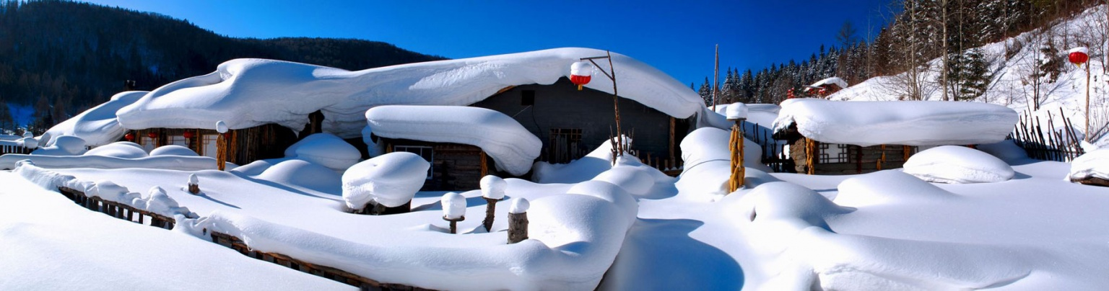
8. China’s Snow Town
China’s Snow Town is the paradise of photographers. It is located in the forest and mountain area of Heilongjiang province. You can take some photos of the wooden houses with red lanterns, go skiing, take the romantic horse/dog sleigh through the forest, take the snowmobile to watch sunrise, visit the local tiny museums. At night, you can taste the local dishes and wines in the farmers’ family restaurants; experience the farmers’ unique kangtou (a kind of heatable brick bed) in their family hotels.

Slide 22
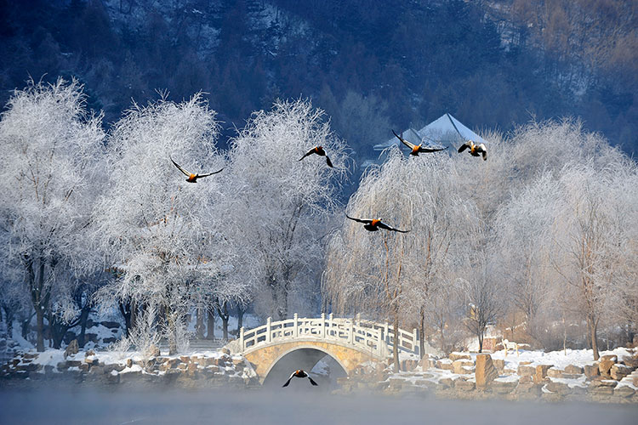
9. Benxi Water Cave
Located west of Benxi County, the Benxi Water Cave is a large water-eroded cave that was formed about five million years ago. Stretching from northwest to southeast, it consists of three sections: water cave, dry cave, and drainage. The cave is the longest of its kind that can be visited by tourists on a boat in China.

Slide 23
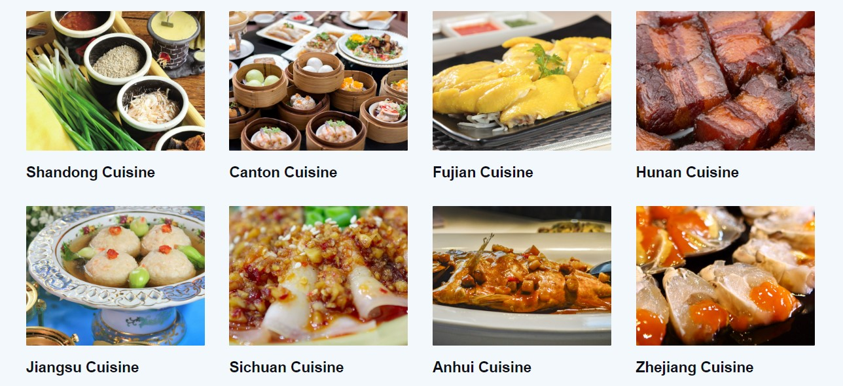
Part 4: Food

Slide 24
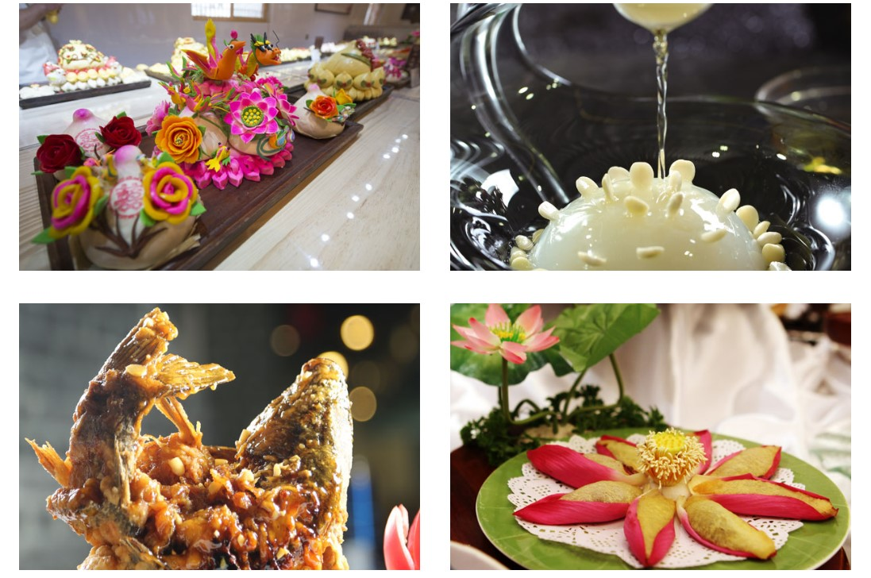
1. Shandong Cuisine
People in Shandong even like to eat foods made of wheat flour as staple food. It’s common to see that Shandong people eat big cakes stuffed with scallions or minced meat when they eat three meals a day. Notable Shandong Dishes: Sweet and Sour Carp, Braised Sea Cucumber with Scallion, Braised Intestines in Brown Sauce, Braised Prawns in Oil, Steamed Stuffed Tofu, Dezhou Braised Chicken, Caramel Sweet Potato, Omelet Chicken Slices, Four Joy Meatballs

Slide 25
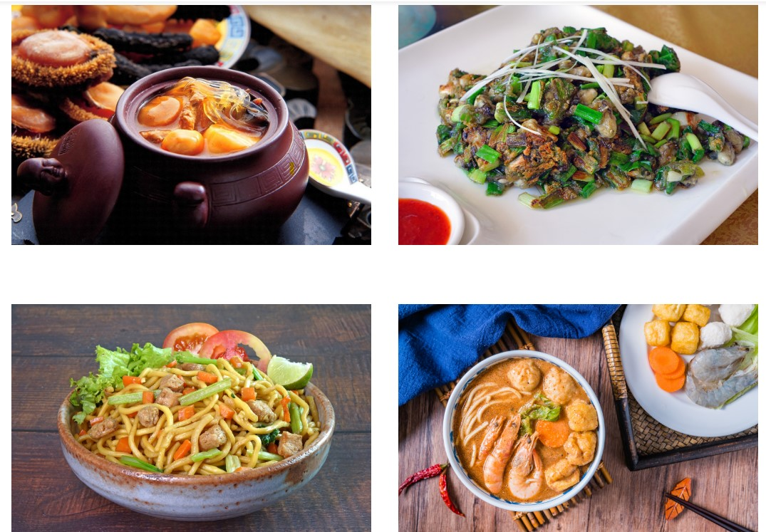
2. Fujian Cuisine
The most characteristic aspect of Fujian cuisine is that the dishes are served in soup. The cooking methods are stewing, boiling, braising, quick-boiling, and steaming. Notable Sichuan Dishes: Buddha Jumps over the Wall, Braised Sea Clam with Chicken Soup, Sweet and Sour Litchis, Sliced Whelk in Red Vinasse, Fuzhou Fish Balls, Oyster Omelette, Drunken Ribs

Slide 26

3. Hunan Cuisine
Hunan Cuisine (Xiang Cuisine) is famous for its hot and spicy. Notable Hunan Dishes: Steamed Fish Head with Chopped Chili, Steamed Preserved Meat, Chairman Mao’s Red Braised Pork, Fried Pork with Chili, Tasty Lobster, Changsha Stinky Tofu, Hunan Rice Noodles, Spicy Salted Duck

Slide 27
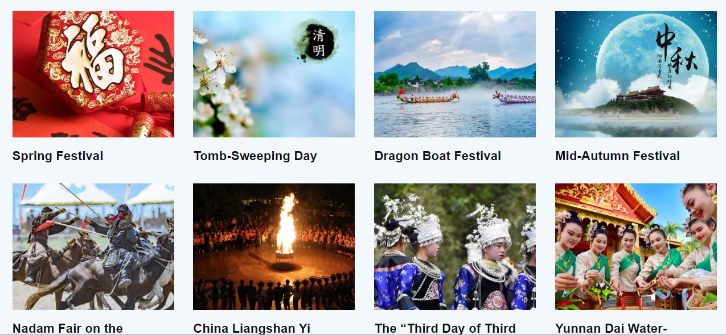
Part 5: Festivals

Slide 28
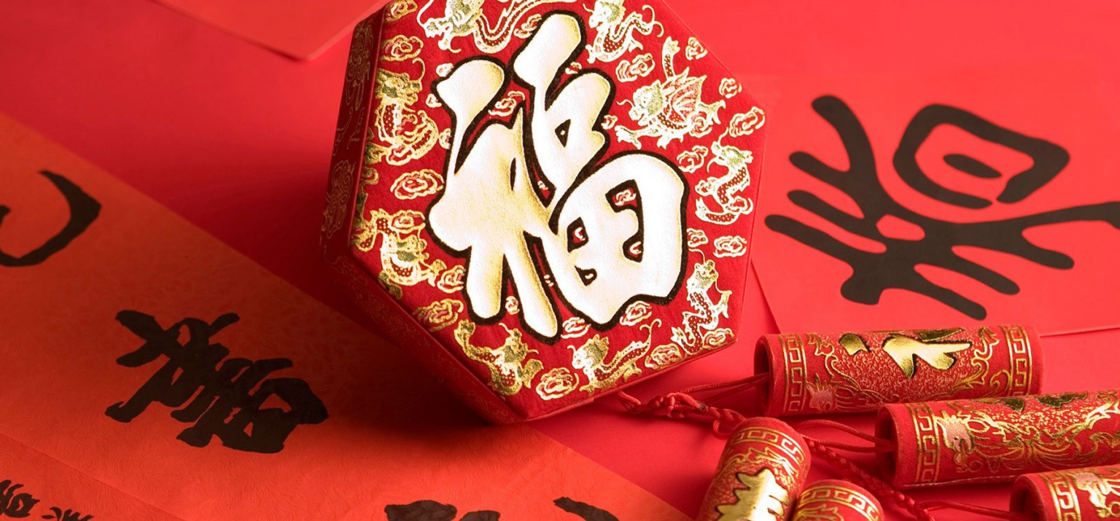
1. Spring Festival
Time
The first day of the first lunar month every year (which generally falls between the last 10-day period of January and the first 10-day period of February)
Venue
All over the country
About After a year’s farm work, the Chinese ancestors held an activity to offer sacrifices to gods and ancestors and celebrate a good harvest at the end of an old year.

Slide 29
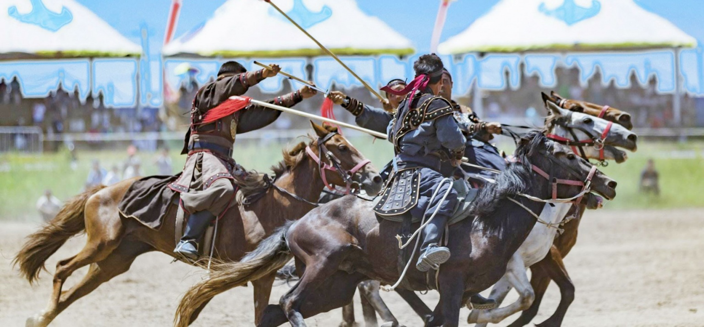
2. Nadam Fair on the grassland
Time
Mid July every year
Venue
All the places in the In­ner Mongolia Autonomous Region
About In the Mongo­lian language, “Nadam” means “recreation” or “game.” As a mass assembly, the Nadam Fair originated from the activity of offer­ing sacrifices to Aobao (stone or earth laid out as a road marker or boundary sign by Mongolians, for­merly also wor­shipped as habita­tion of spirits)

Slide 30
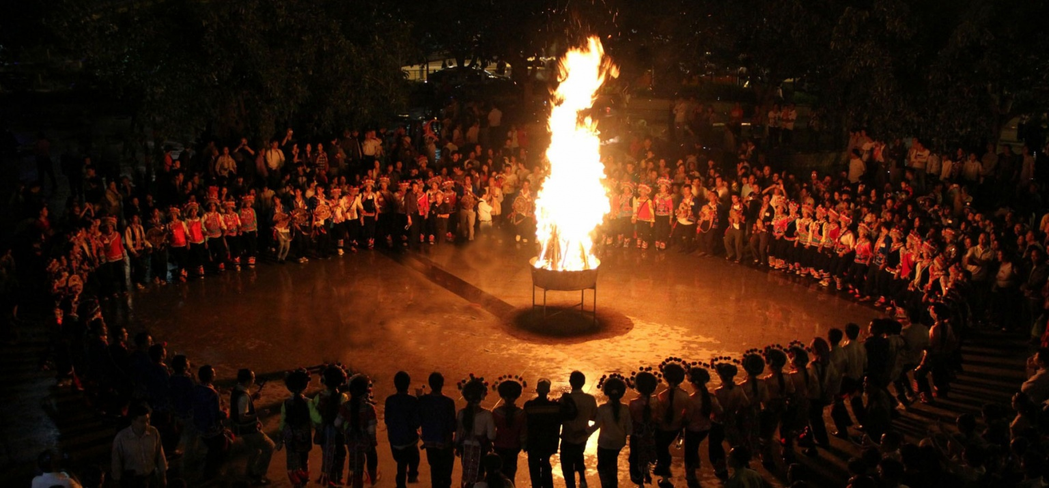
3. China Liangshan Yi International Torch Festival
Time
The festival starts from the 24th day of the sixth lunar month and lasts three days and nights.
Venue
Liangshan Yi Autonomous Prefecture in Sichuan Province
Called “Duzai” in the Yi language of Liangshan, the Torch Festival is the most important traditional holiday for the Yi people, featuring the richest contents, the most magnificent scenes, the most participants and the strongest ethnic flavor. There are many legends on the origin of the festival. One story goes that the remote antiquity, the Yi people held torches to eliminate pests and defeat heavenly gods; and another legend notes that the Yi people held high torches to commemorate brave women who resisted against being grabbed away for forced marriage. Every story is interesting and moving. In a word, the Yi people regard fire as the embodiment of gods, the source of a prosperous family and the symbol of holiness and happiness.

Slide 31
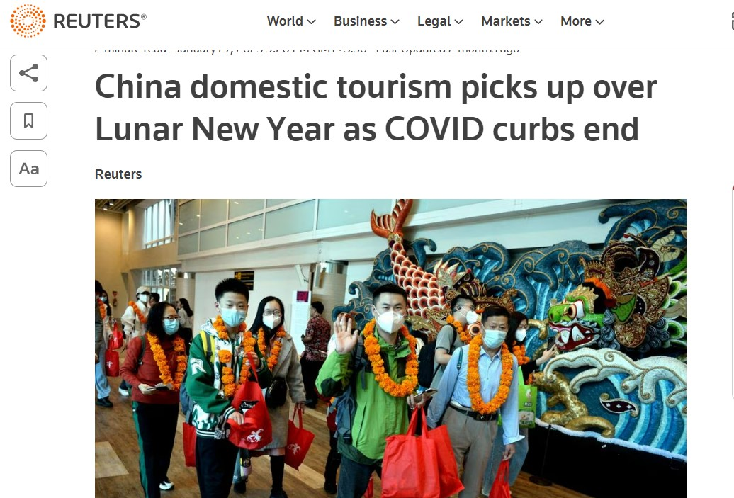
Part 6: Covid Update in China and its Impact on Tourism

Slide 32
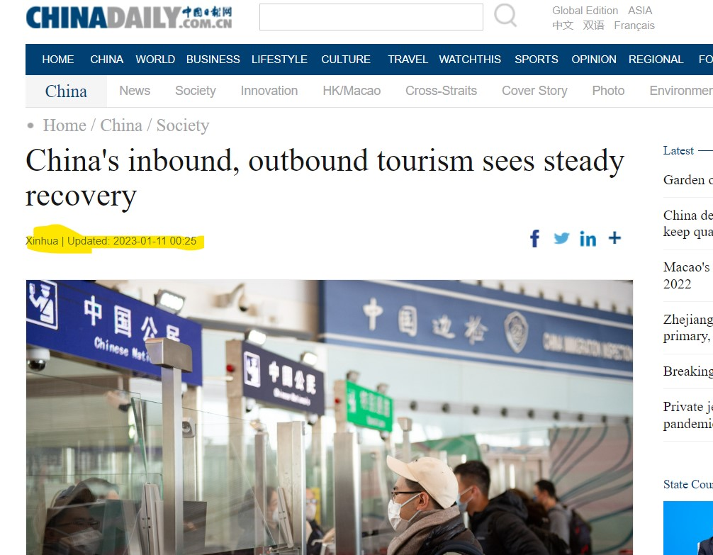
Covid Update in China and its Impact on Tourism
As per China Daily Report (11/Jan/2023) The country has made an array of active adjustments to its COVID-19 response, including 20 measures in November, 10 new measures in December, and changing the Chinese term for COVID-19 from "novel coronavirus pneumonia" to "novel coronavirus infection". China's inbound and outbound tourism market saw a steady and gradual recovery at the beginning of 2023. Judging from leading indicators such as air ticket searches and travel intentions, Japan, the Republic of Korea, Thailand and China's Hong Kong and Macao are likely to be the first outbound tourist destinations to recover, followed by medium and long-distance markets such as West Asia and Europe, said Dai Bin, president of the China Tourism Academy.

Slide 33
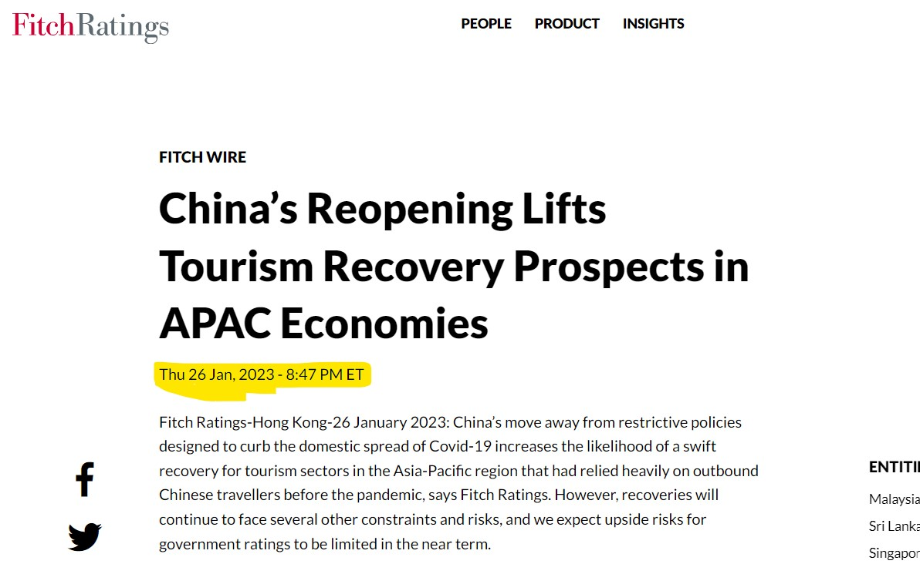
Covid Update in China and its Impact on Tourism
China was one of the world’s largest tourism source markets before the pandemic, with total international tourism expenditure of USD254.6 billion in 2019.
China’s easing of Covid-19-related travel restrictions has occurred faster than anticipated, and will create upside risks to the forecasts.

Slide 34
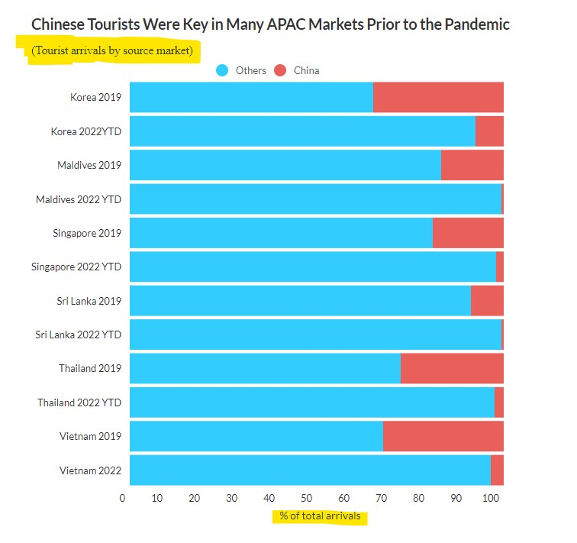
Covid Update in China and its Impact on Tourism
Outbound Tourism in China Chinese tourists could also provide varying degrees of support to macroeconomic performance in Singapore (AAA/Stable), Vietnam (BB/Positive) and Sri Lanka (RD). Chinese tourists comprised 16.7% of arrivals in the Maldives (B-/Negative) in 2019. However, the potential upside to the Maldives’ real GDP growth from China’s opening is limited by the tourism sector’s already-strong recovery and capacity constraints

Slide 35
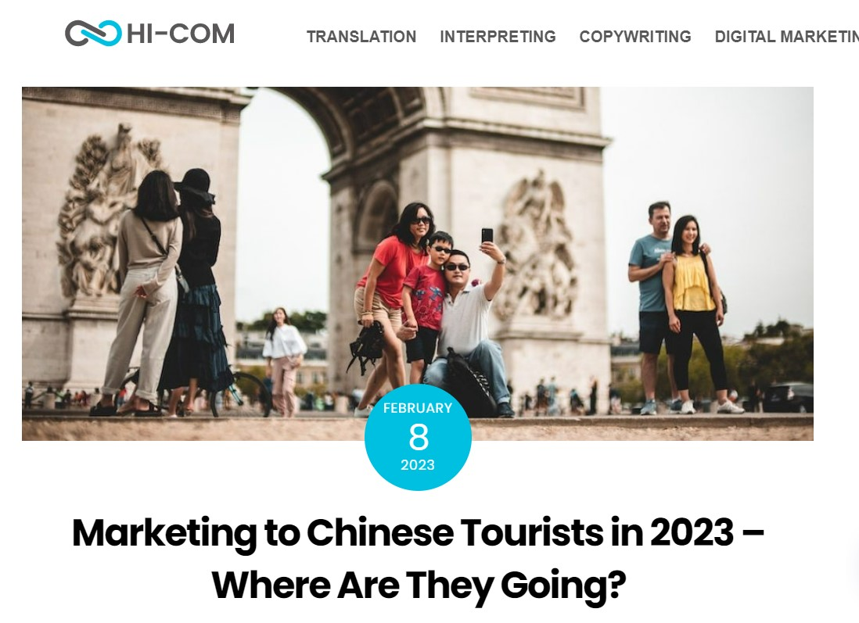
Covid Update in China and its Impact on Tourism

Slide 36
Part 7: SWOT Analysis of China’s Tourism Industry

Slide 37
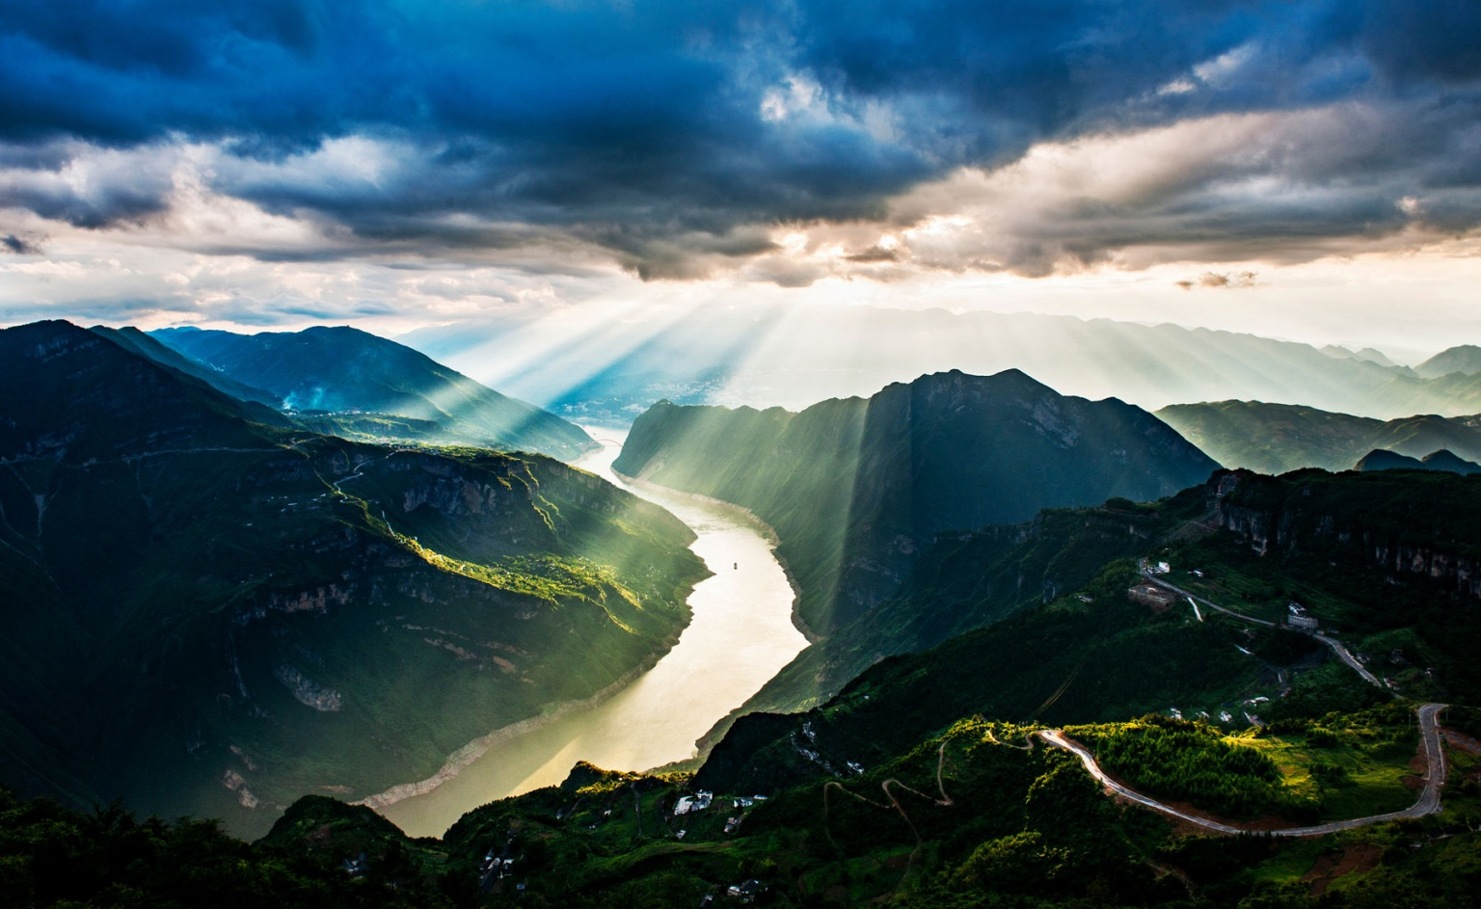
1. Strengths
1. Rich cultural heritage and diverse tourist attractions: China boasts of a rich cultural heritage and a diverse range of tourist attractions, such as the Great Wall of China, the Terracotta Warriors, the Forbidden City, and many more.
2. Large domestic tourism market: China has a massive domestic tourism market, with a population of over 1.4 billion people.
3. Government support: The Chinese government has been actively supporting the development of the tourism industry in recent years, providing funding and incentives for the construction of tourist infrastructure and promoting tourism-related policies.
4. Growing middle class: The middle class in China is growing, and with it, their desire to travel and explore different destinations, leading to a boom in the tourism industry.
5. Strong tourism infrastructure: China has invested heavily in its tourism infrastructure, with world-class airports, high-speed railways, and modern hotels.

Slide 38
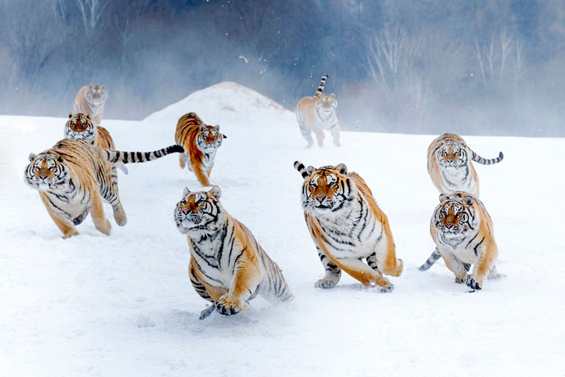
2. Weaknesses
1. Language barrier: English is not widely spoken in China, which can be a challenge for foreign tourists trying to navigate the country.
2. Safety concerns: Some areas of China, particularly in remote regions, can be perceived as unsafe due to a lack of law enforcement or infrastructure.
3. Pollution: China's air and water pollution can be a deterrent for tourists, especially those with health concerns.
4. Limited tourism infrastructure in some areas: While China has invested heavily in its tourism infrastructure, some remote areas may lack the necessary facilities to attract tourists.
5. Restrictions on internet access: The Chinese government has strict controls on internet access, which can be a challenge for foreign tourists trying to research or plan their trips.

Slide 39
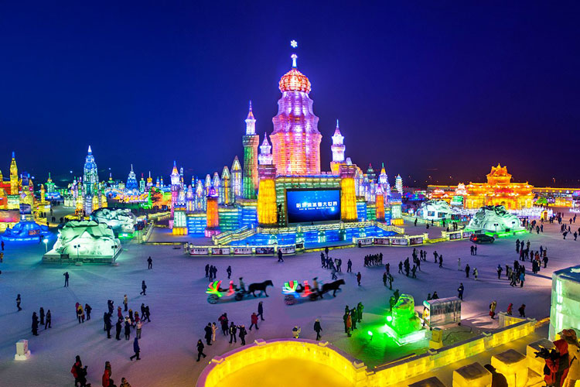
3. Opportunities
1. International tourism growth: China has seen a steady increase in international tourists in recent years, presenting an opportunity for further growth.
2. New tourism products: China has an opportunity to develop new tourism products, such as adventure sports and ecotourism, to attract a broader range of tourists.
3. Medical tourism: China's traditional medicine practices and modern medical facilities present an opportunity for the development of medical tourism.
4. Increased investment: There is an opportunity for increased investment in the tourism industry, particularly in infrastructure development and marketing efforts.
5. Digital transformation: China can leverage digital technologies, such as virtual reality and online booking platforms, to enhance the tourism experience and attract more tourists.

Slide 40
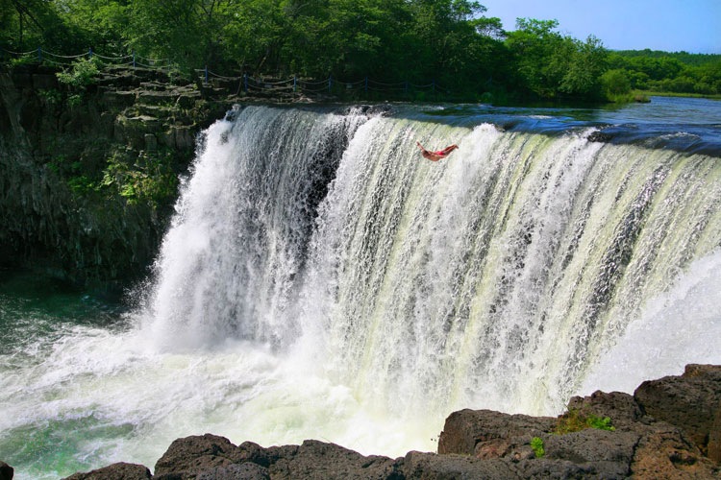
4. Threats
1. Political instability: Political instability can deter tourists from visiting, particularly in areas of unrest.
2. Economic uncertainty: Economic uncertainty can impact travel spending, leading to a decline in tourism.
3. Natural disasters: Natural disasters, such as earthquakes and typhoons, can disrupt travel plans and impact tourism.
4. Competition from other destinations: China faces competition from other destinations, particularly in the Asia-Pacific region, such as Japan and South Korea.
5. Negative publicity: Negative publicity, such as reports of pollution or safety concerns, can impact the perception of China as a tourist destination.

Slide 41
Video Links
Anhui Province, China: https://www.youtube.com/watch?v=dsu-yxGYf94&t=138s Chongquing, China: https://www.youtube.com/watch?v=IJZzpPt9unw Shanghai, China: https://www.youtube.com/watch?v=qxMOgfAOR2c Guizhou, China: https://www.youtube.com/watch?v=8L_lzG6U02U Hunan Province, China: https://www.youtube.com/watch?v=MZpLvi6dhf8 Heilongjiang Province: https://www.youtube.com/watch?v=v0pNj8RVMmE

Slide 42
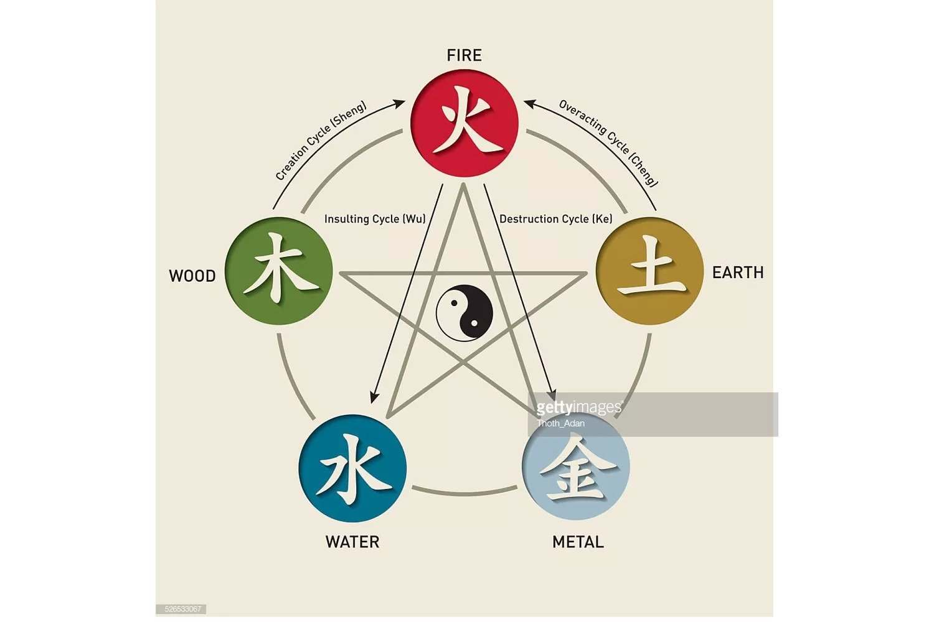
Thank You!

